Slide 1

Reconocimiento de Patrones
Domingo Mery
Departmento de Ciencia de la Computación
Escuela de Ingeniería
Universidad Católica de Chile
Deep Learning
[ Capítulo 4 ]

Slide 2
Motivation

Slide 3
Images of different
known classes
Representation
Class 1
Feature Feature Design of
Extraction Selection Classifier
Class 2
Class n
Stage 1: TRAINING
Stage 2: TESTING
Extraction of
selected
features
InputA: Test Image
Class
Classification
Output:

Slide 4
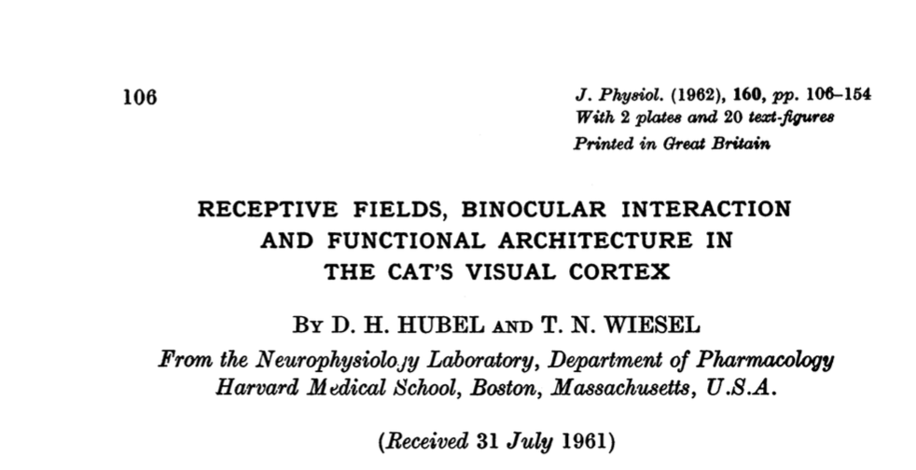
MOTIVATION
Cat experiments in the 60’s: Hubel & Wiesel
[ Video 1 ] [ Video 2 ] [ Paper ]

Slide 5
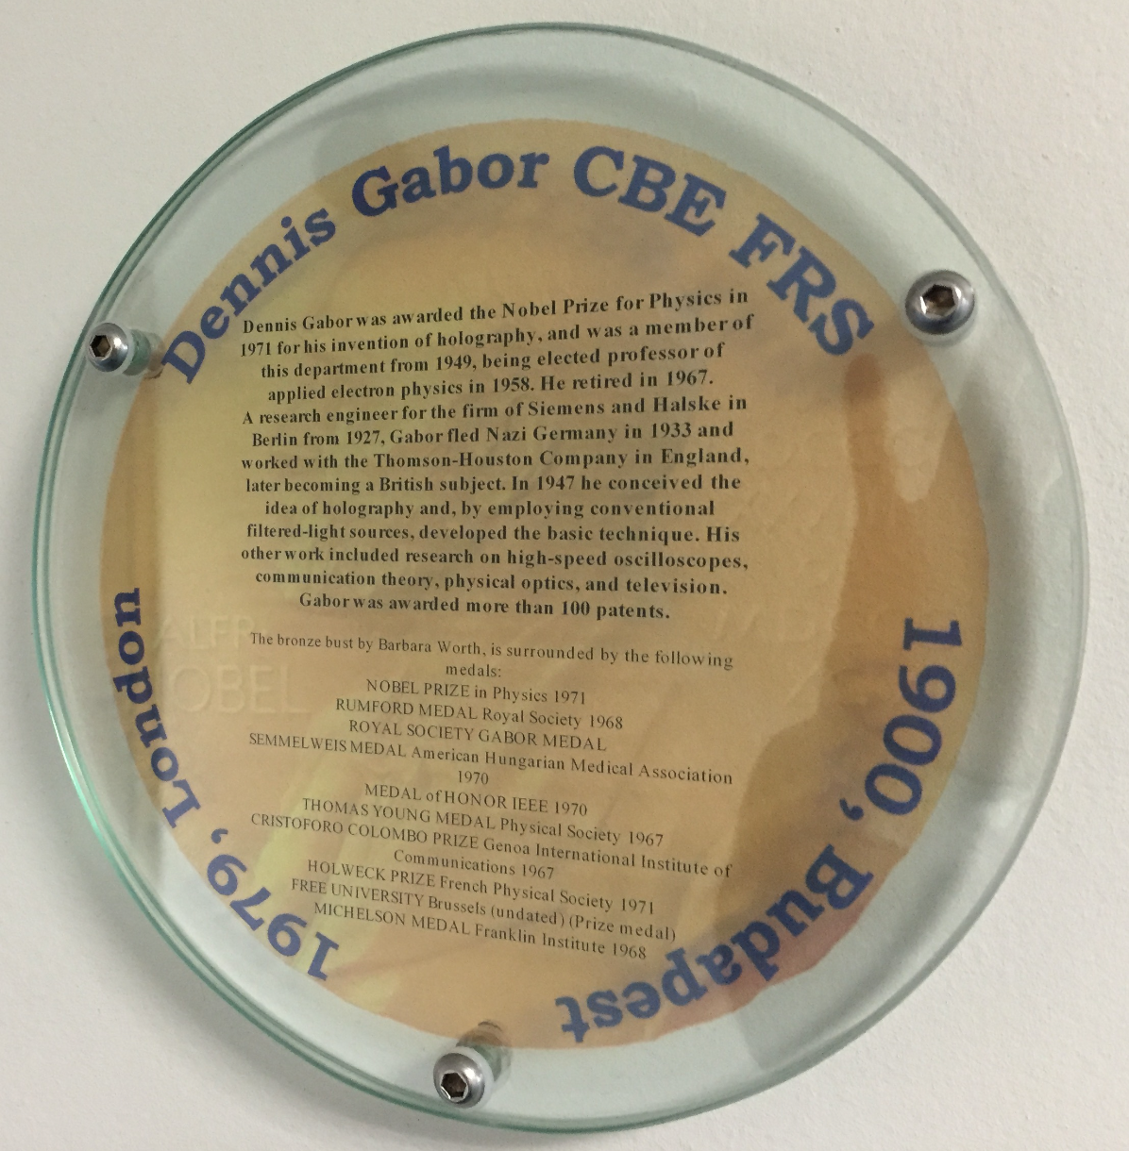
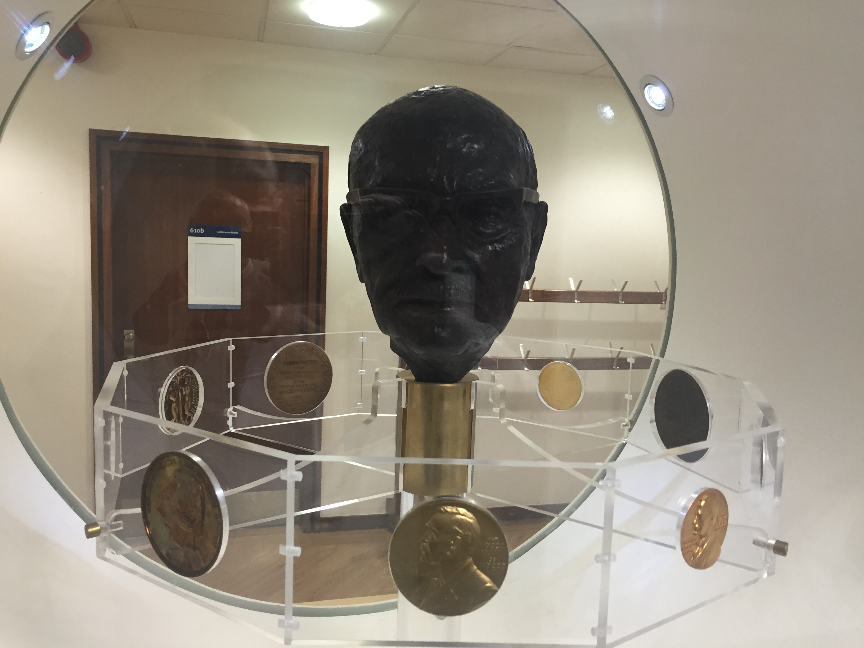
MOTIVATION
Gabor

Slide 6
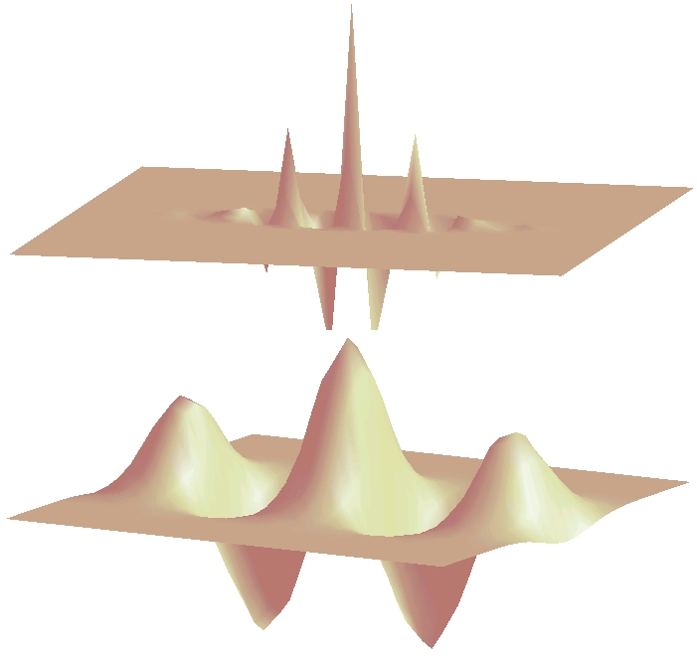
MOTIVATION
Gabor

Slide 7
MOTIVATION
Handcrafted vs. Learned features
LBP, Haralick, Fourier, Gabor, etc.
or
Learned representation from training data

Slide 8
MOTIVATION
Neural networks
x₁
x₂
y
:
:
x_{n}

Slide 9
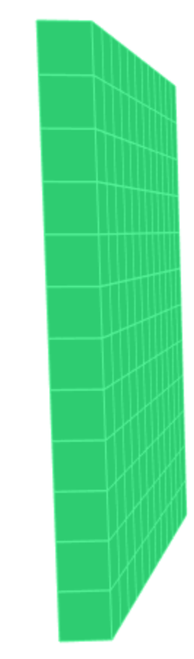

MOTIVATION
What happens if each pixel is an input?
y
How many neurons and weights?

Slide 10
Basics

Slide 11
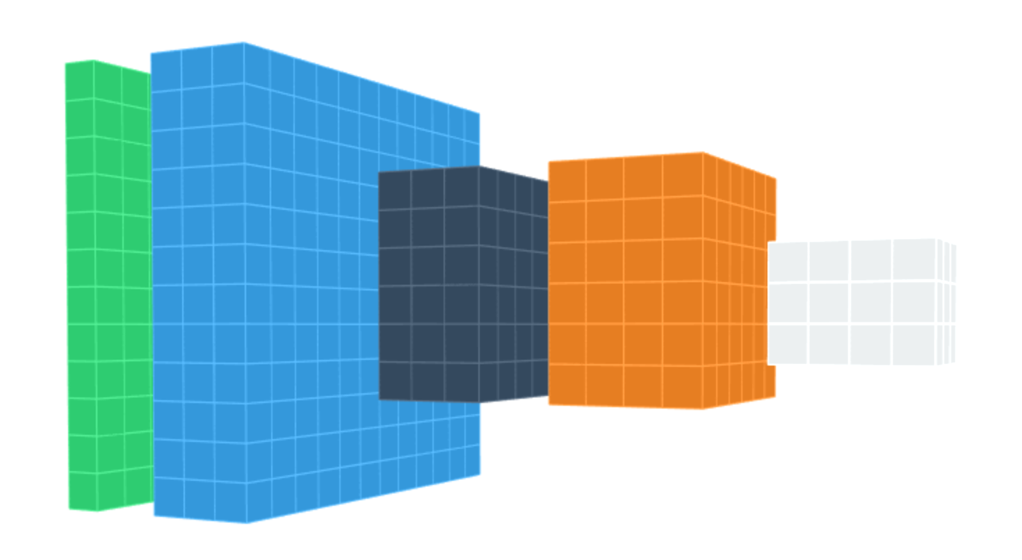
DEEP LEARNING BASICS
Data
representation
Input
image
Layers

Slide 12
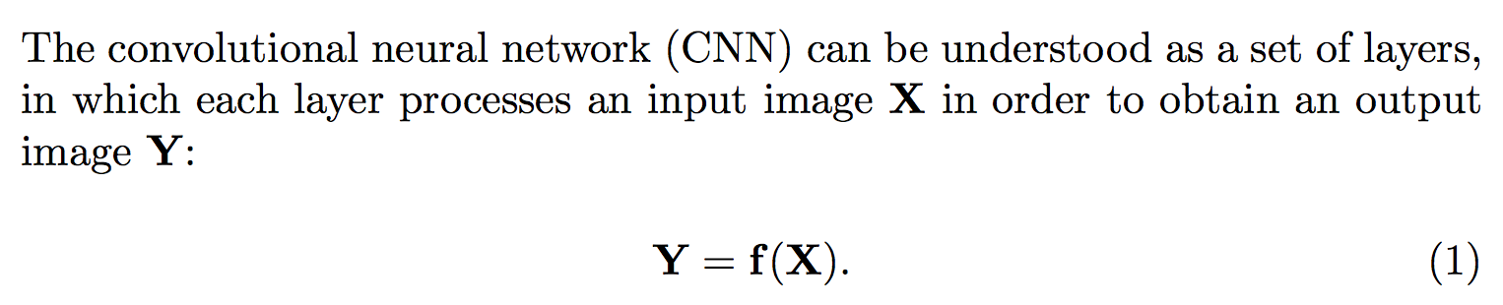
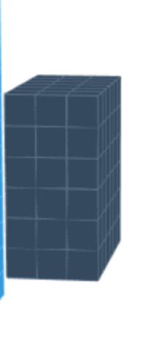
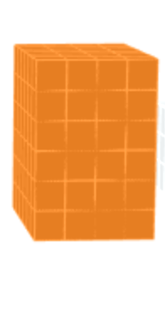
DEEP LEARNING BASICS
f
X
Y
parameters (to be learned)

Slide 13
DEEP LEARNING BASICS
Each layer:
f
X
Y

Slide 14
DEEP LEARNING BASICS
f₁
f₂
f₃
f₄
Data
representation
Input
image
Layers

Slide 15
DEEP LEARNING: Typical layers
Convolution layer
Pooling layer
Rectified Linear Unit
Downsampling
Fully connected and SoftMax

Slide 16
DEEP LEARNING: Typical layers
Convolution layer
Pooling layer
Rectified Linear Unit
Downsampling
Fully connected and SoftMax

Slide 17
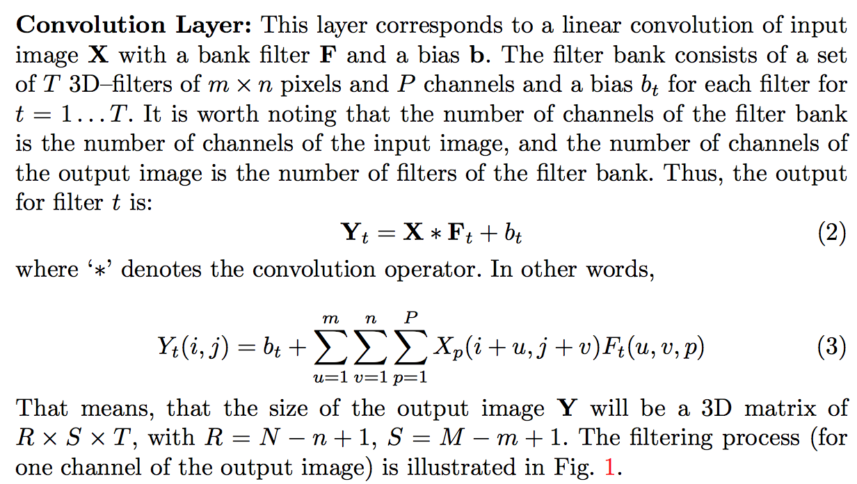
DEEP LEARNING: Convolution layer

Slide 18
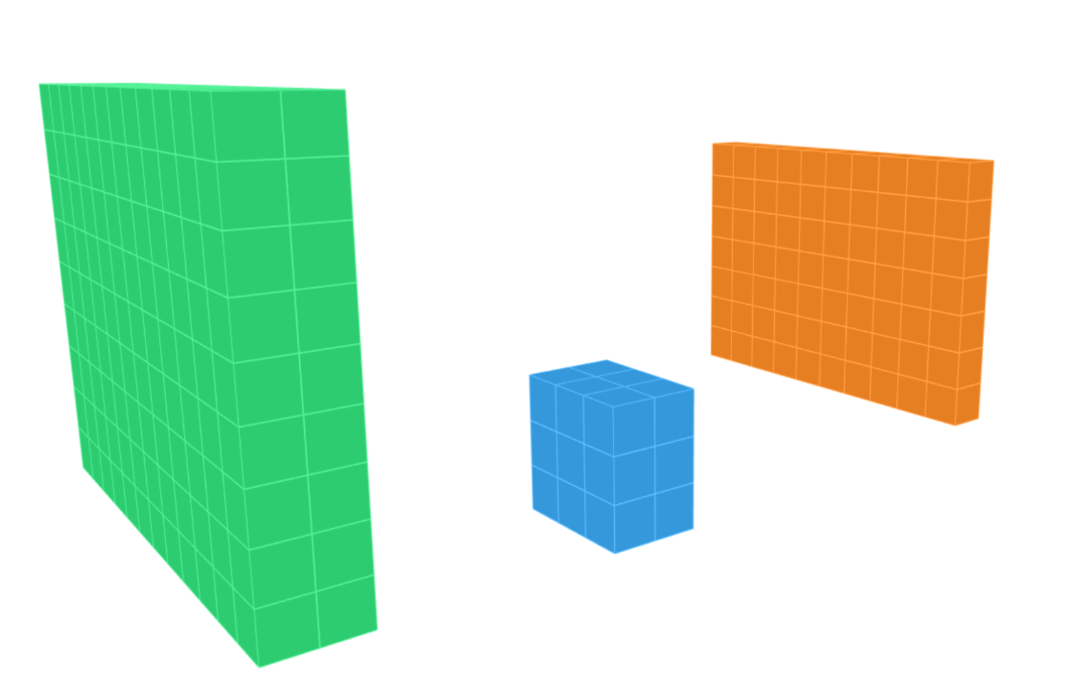
DEEP LEARNING: Convolution layer
X
N-n+1
M
M-m+1
m
N
n
for
P

Slide 19
DEEP LEARNING: Typical layers
Convolution layer
Pooling layer
Rectified Linear Unit
Downsampling
Fully connected and SoftMax

Slide 20
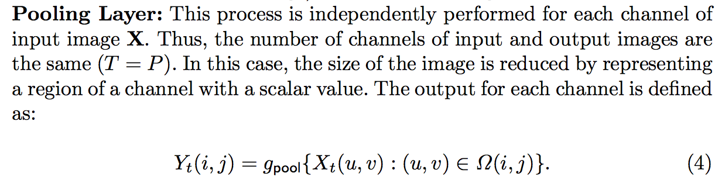
DEEP LEARNING: Pooling layer

Slide 21
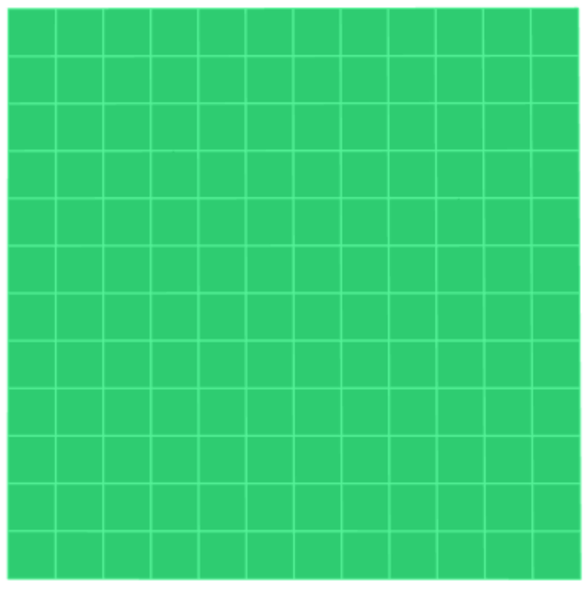
DEEP LEARNING: Pooling layer
max

Slide 22
DEEP LEARNING: Pooling layer
max

Slide 23
DEEP LEARNING: Pooling layer
max

Slide 24
DEEP LEARNING: Pooling layer
max

Slide 25

DEEP LEARNING: Pooling layer
max

Slide 26
DEEP LEARNING: Typical layers
Convolution layer
Pooling layer
Rectified Linear Unit
Downsampling
Fully connected and SoftMax

Slide 27
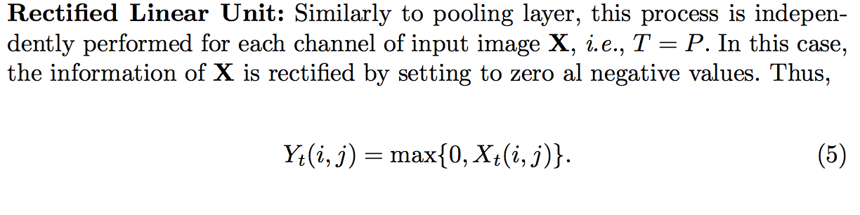
DEEP LEARNING: Rectified Linear Unit (ReLU)

Slide 28
DEEP LEARNING: Rectified Linear Unit (ReLU)

Slide 29
DEEP LEARNING: Typical layers
Convolution layer
Pooling layer
Rectified Linear Unit
Downsampling
Fully connected and SoftMax

Slide 30
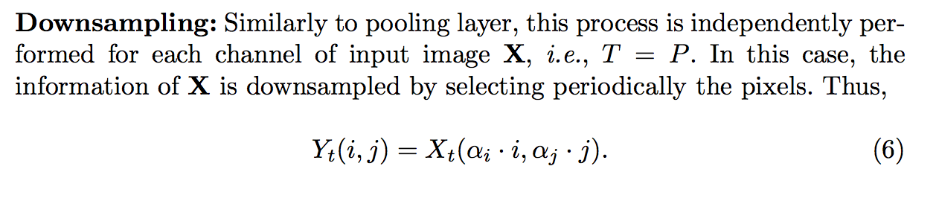
DEEP LEARNING: Downsampling

Slide 31
DEEP LEARNING: Downsampling

Slide 32
DEEP LEARNING: Typical layers
Convolution layer
Pooling layer
Rectified Linear Unit
Downsampling
Fully connected and SoftMax

Slide 33
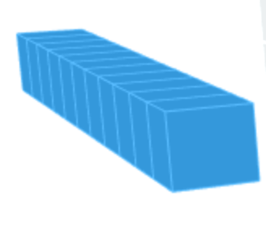
DEEP LEARNING: Fully Connected
one to one

Slide 34
DEEP LEARNING: SoftMax

Slide 35
Training

Slide 36
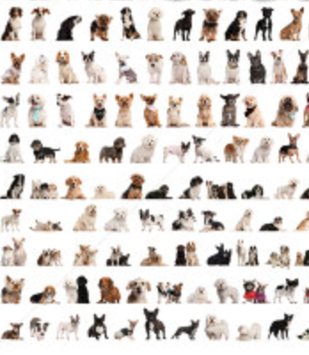
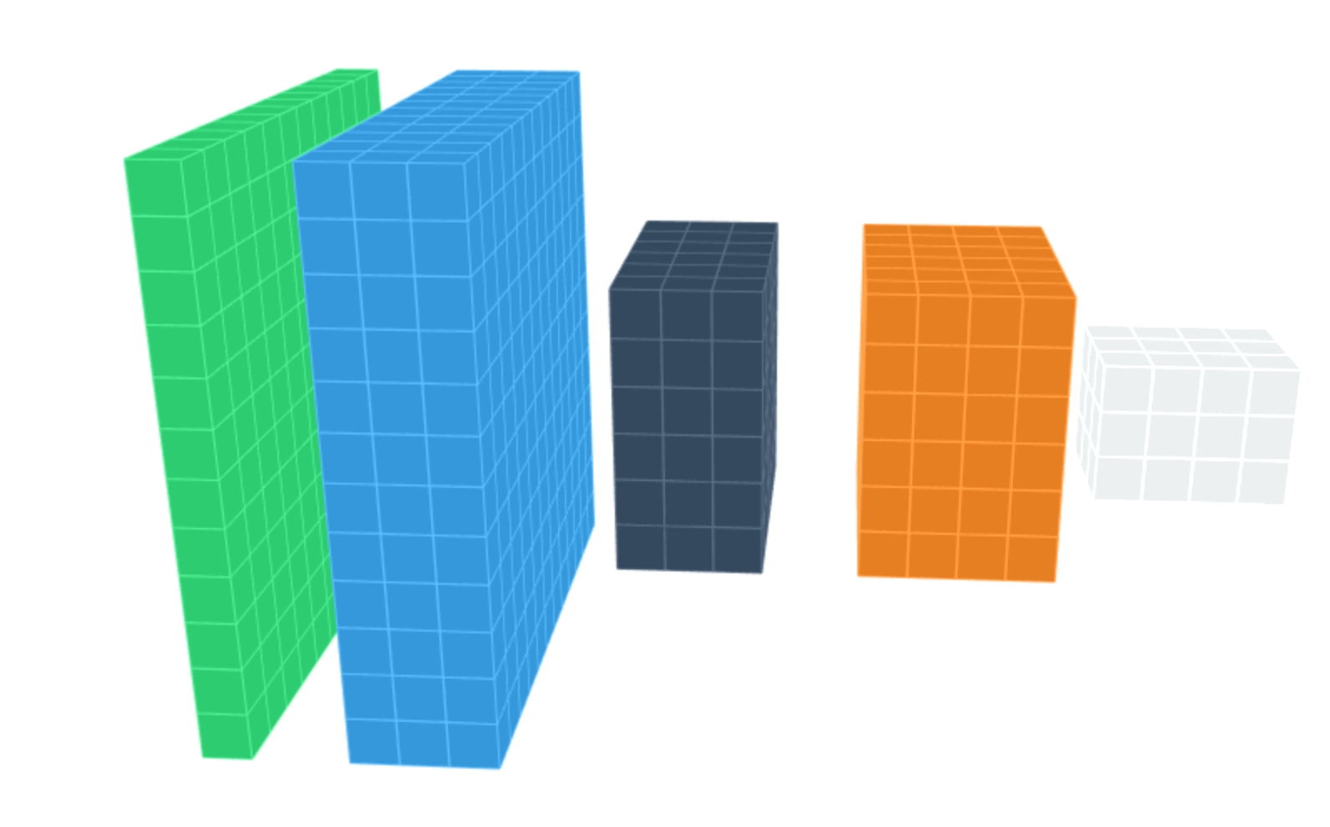


DEEP LEARNING: Training
dogs
errors
cats
Back-propagation

Slide 37
Example

Slide 38
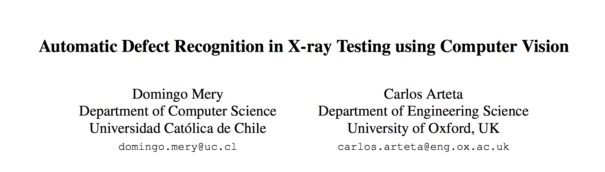
Mery, D.; and Arteta, C. Automatic Defect Recognition in X-ray Testing using Computer Vision. In 2017 IEEE Winter Conference on Applications of Computer Vision (WACV2017), 2017. [ PDF ]
PPT > PAT04_CNN_Example_WACV.pptx

Slide 39
State of the Art

Slide 40
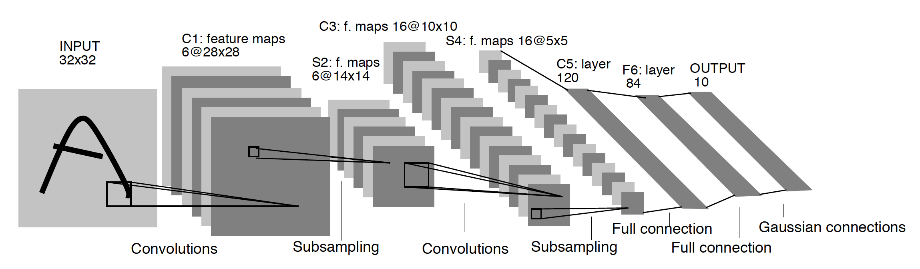
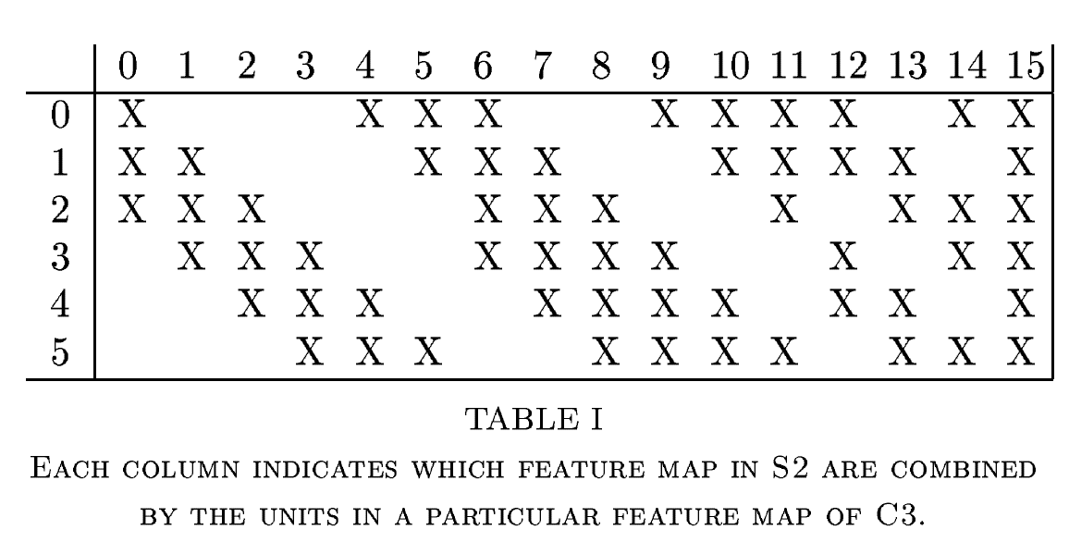
Digits recognition [ LeNet]
Y. LeCun, L. Bottou, Y. Bengio, and P. Haffner, “Gradient-based learning applied to document recognition,” Proceedings of the IEEE, vol. 86, no. 11, pp. 2278–2324, Nov. 1998. [ PDF ]

Slide 41
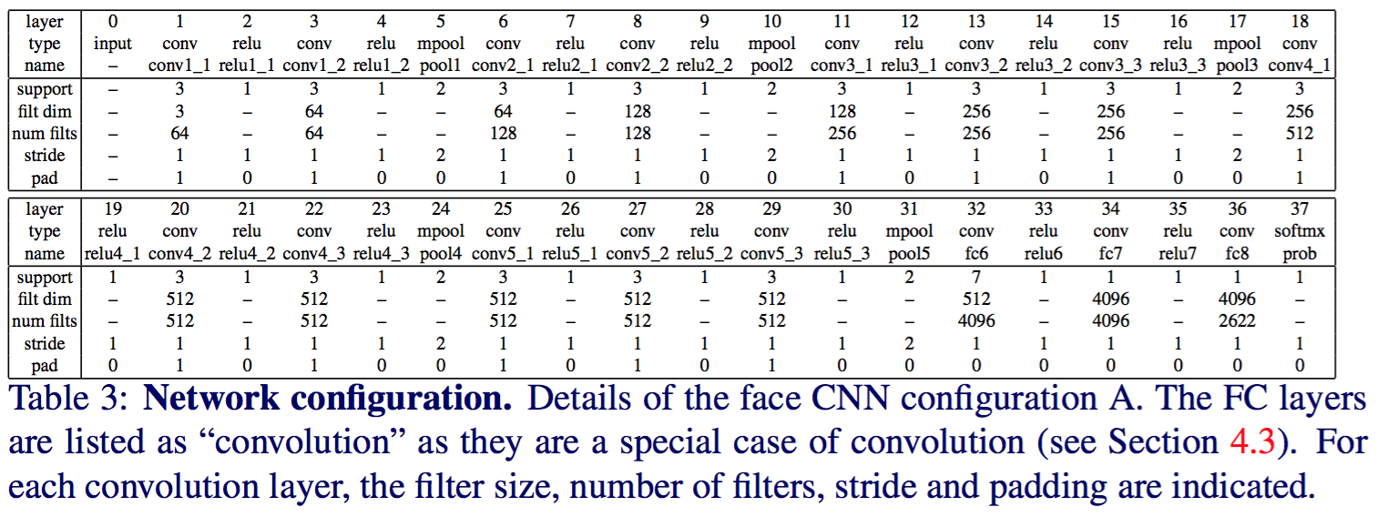
Face Recognition
O. M. Parkhi, A. Vedaldi, and A. Zisserman, “Deep face recognition,” presented at the Proceedings of the British Machine Vision Conference, 2015. [ PDF ]

Slide 42
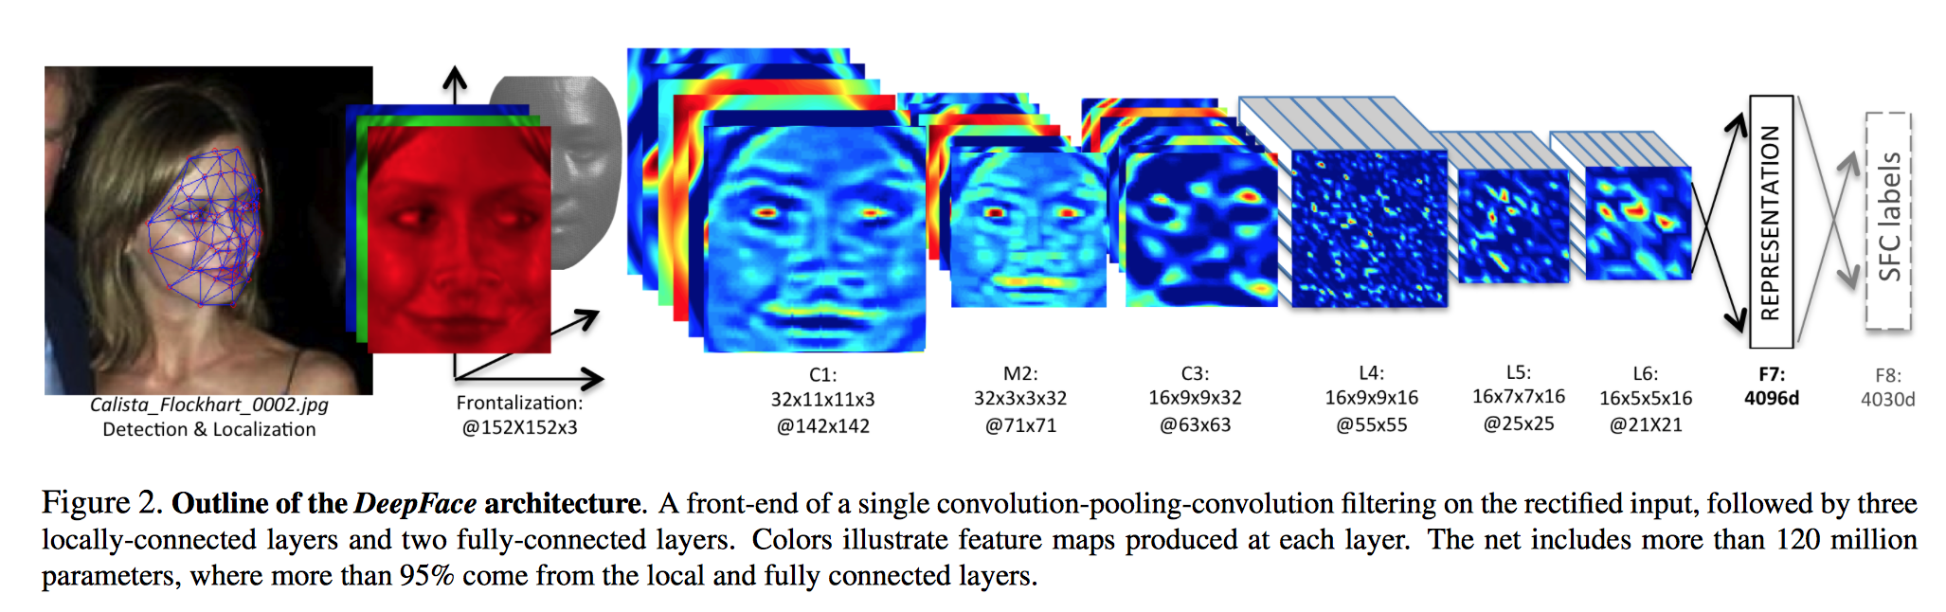
Face Recognition [ DeepFace ]
Taigman, Yaniv, et al. "Deepface: Closing the gap to human-level performance in face verification." Proceedings of the IEEE Conference on Computer Vision and Pattern Recognition. 2014. [ PDF ]

Slide 43
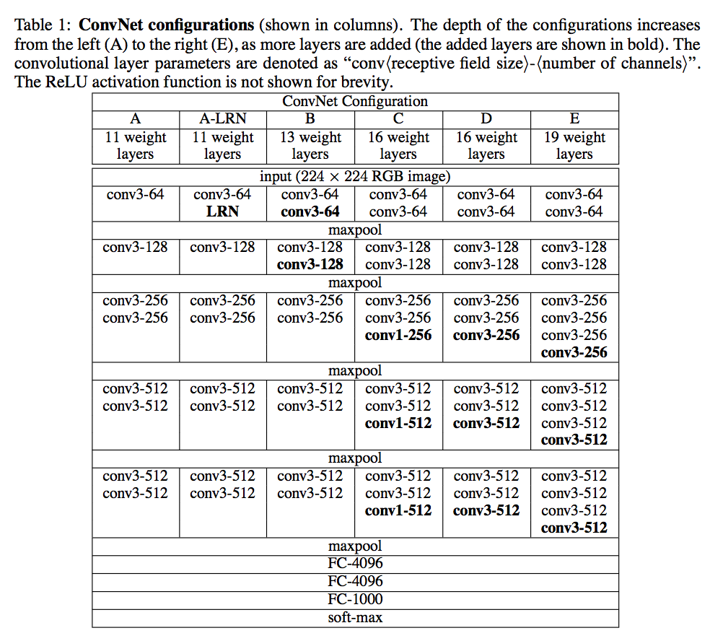
Object recognition
K. Simonyan and A. Zisserman, “Very Deep Convolutional Networks for Large-Scale Image Recognition.,” CoRR abs/1409.1556, 2014. [ PDF ]

Slide 44
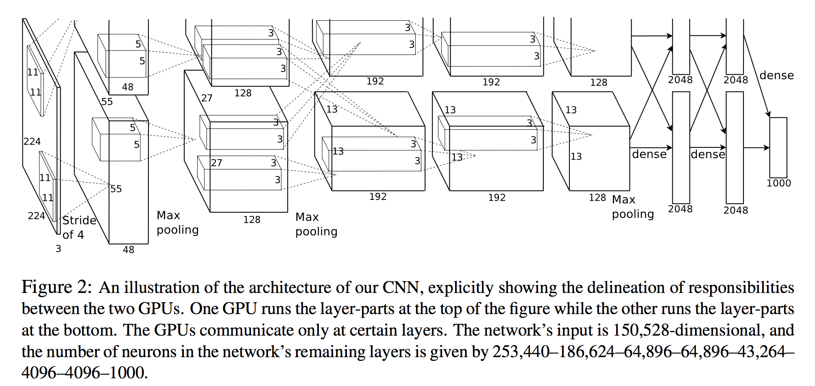
Object recognition [ AlexNet ]
A. Krizhevsky, I. Sutskever, and G. E. Hinton, “ImageNet Classification with Deep Convolutional Neural Networks.,” NIPS, pp. 1106–1114, 2012. [ PDF ]

Slide 45
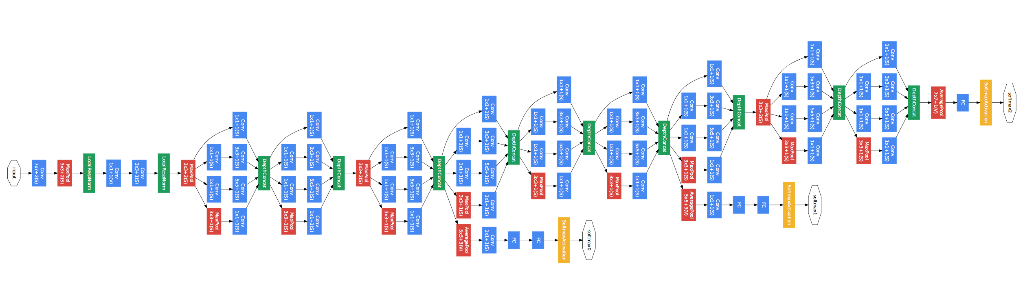
Object recognition [ GoogLeNet ]
Szegedy, Christian, Wei Liu, Yangqing Jia, Pierre Sermanet, Scott Reed, Dragomir Anguelov, Dumitru Erhan, Vincent Vanhoucke, and Andrew Rabinovich. "Going deeper with convolutions." In Proceedings of the IEEE Conference on Computer Vision and Pattern Recognition, pp. 1-9. 2015. [ PDF ]

Slide 46
References
See papers, books, courses, etc.
http://jiwonkim.org/awesome-deep-vision/
Neural networks and deep learning (book)
http://deeplearning.net/

Slide 47
Software

Slide 48
Software for Deep Learning
http://deeplearning.net/software_links/
MatConvNet > Examples
TensorFlow
Keras
etc.

